Slide 1

An Update on the REACH experiment and its Bayesian Data Analysis Pipeline
Dominic Anstey
On behalf of the REACH collaboration

Slide 2

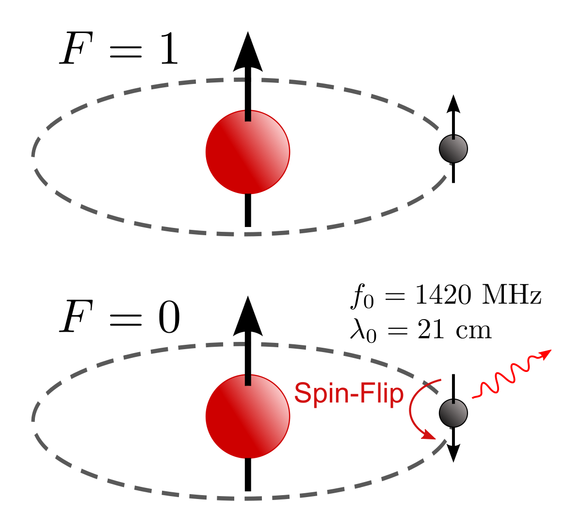
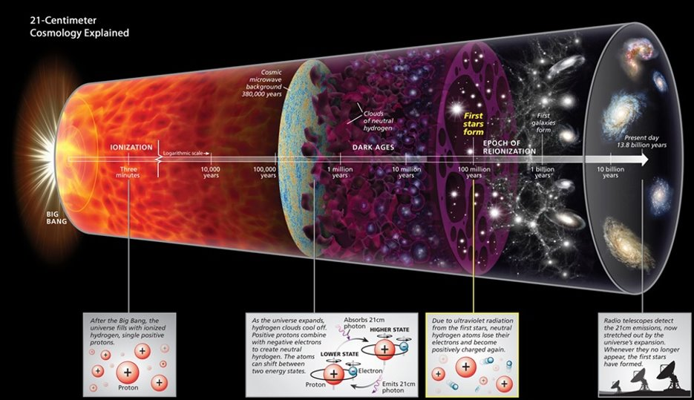
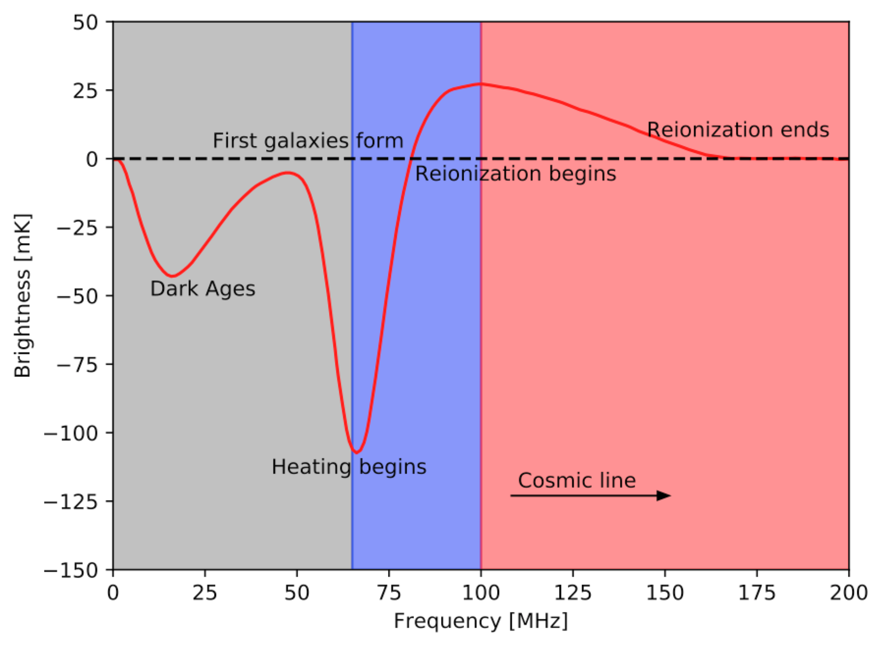
Global 21cm Experiments
https://en.wikipedia.org/wiki/Hydrogen_line
Roen Kelly, Discover Magazine
https://www.astro.phy.cam.ac.uk/research/research-projects/reach/overview

Slide 3
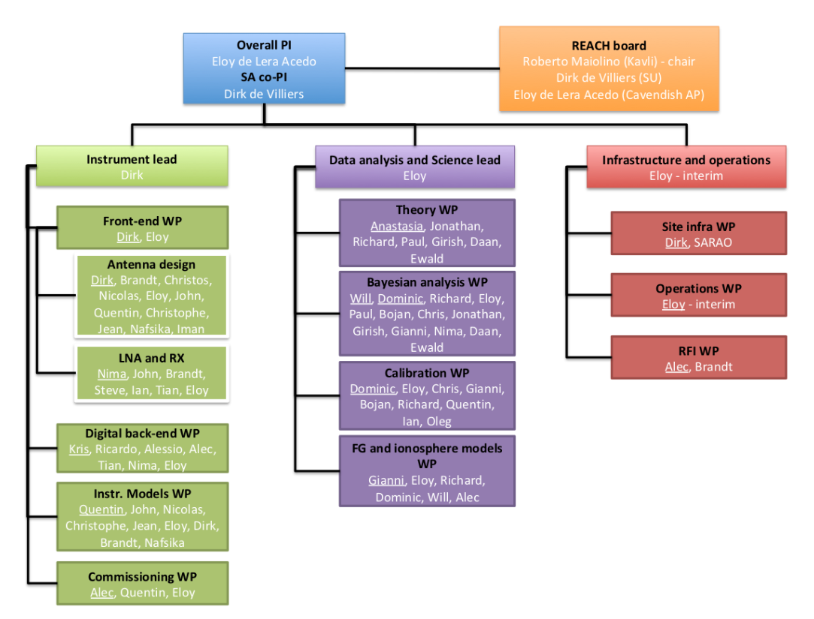


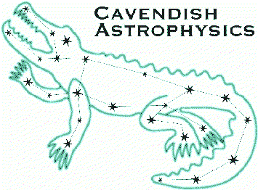















Kavli Institute
for Cosmology
in Cambridge
The Kavli
Foundation
Cavendish
Astrophysics
Stellenbosch
University
Cambridge
University
National Research Foundation
South African Radio
Astronomy Observatory
Imperial
College
Leibniz-Institut für
Astrophysik Potsdam
Groningen
University
Tata Institute
for
Fundamental
Research
University
Carlos III
Madriid
Université catholique
de Louvain
Oxford
University
University
of Malta
Rhodes
University
Sussex University

Slide 4
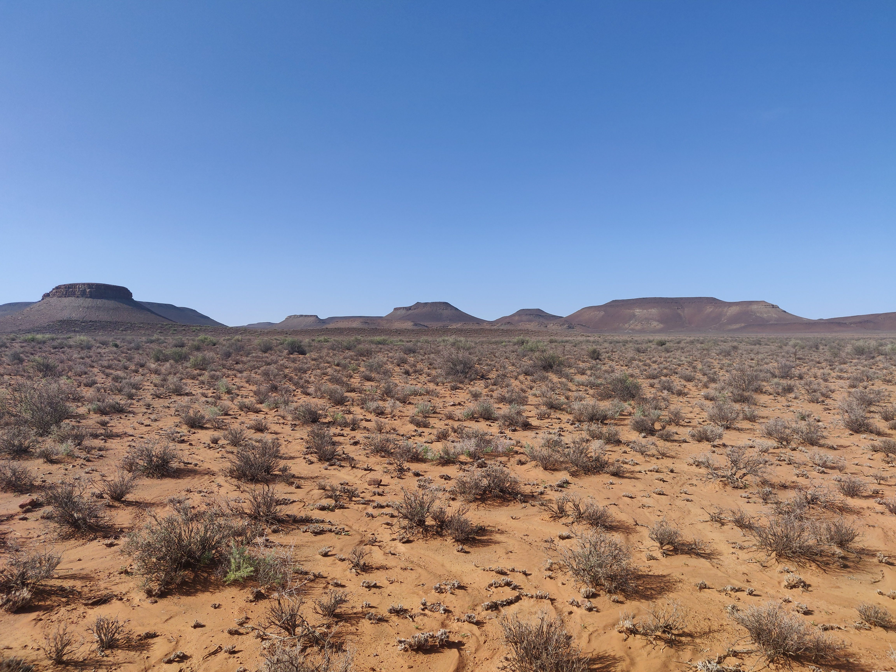
REACH Summary
Designed with Bayesian calibration and data analysis in mind
Use physics-rooted, physically interpretable models to understand and account for systematics
Simultaneous observations with two different antennae

Slide 5
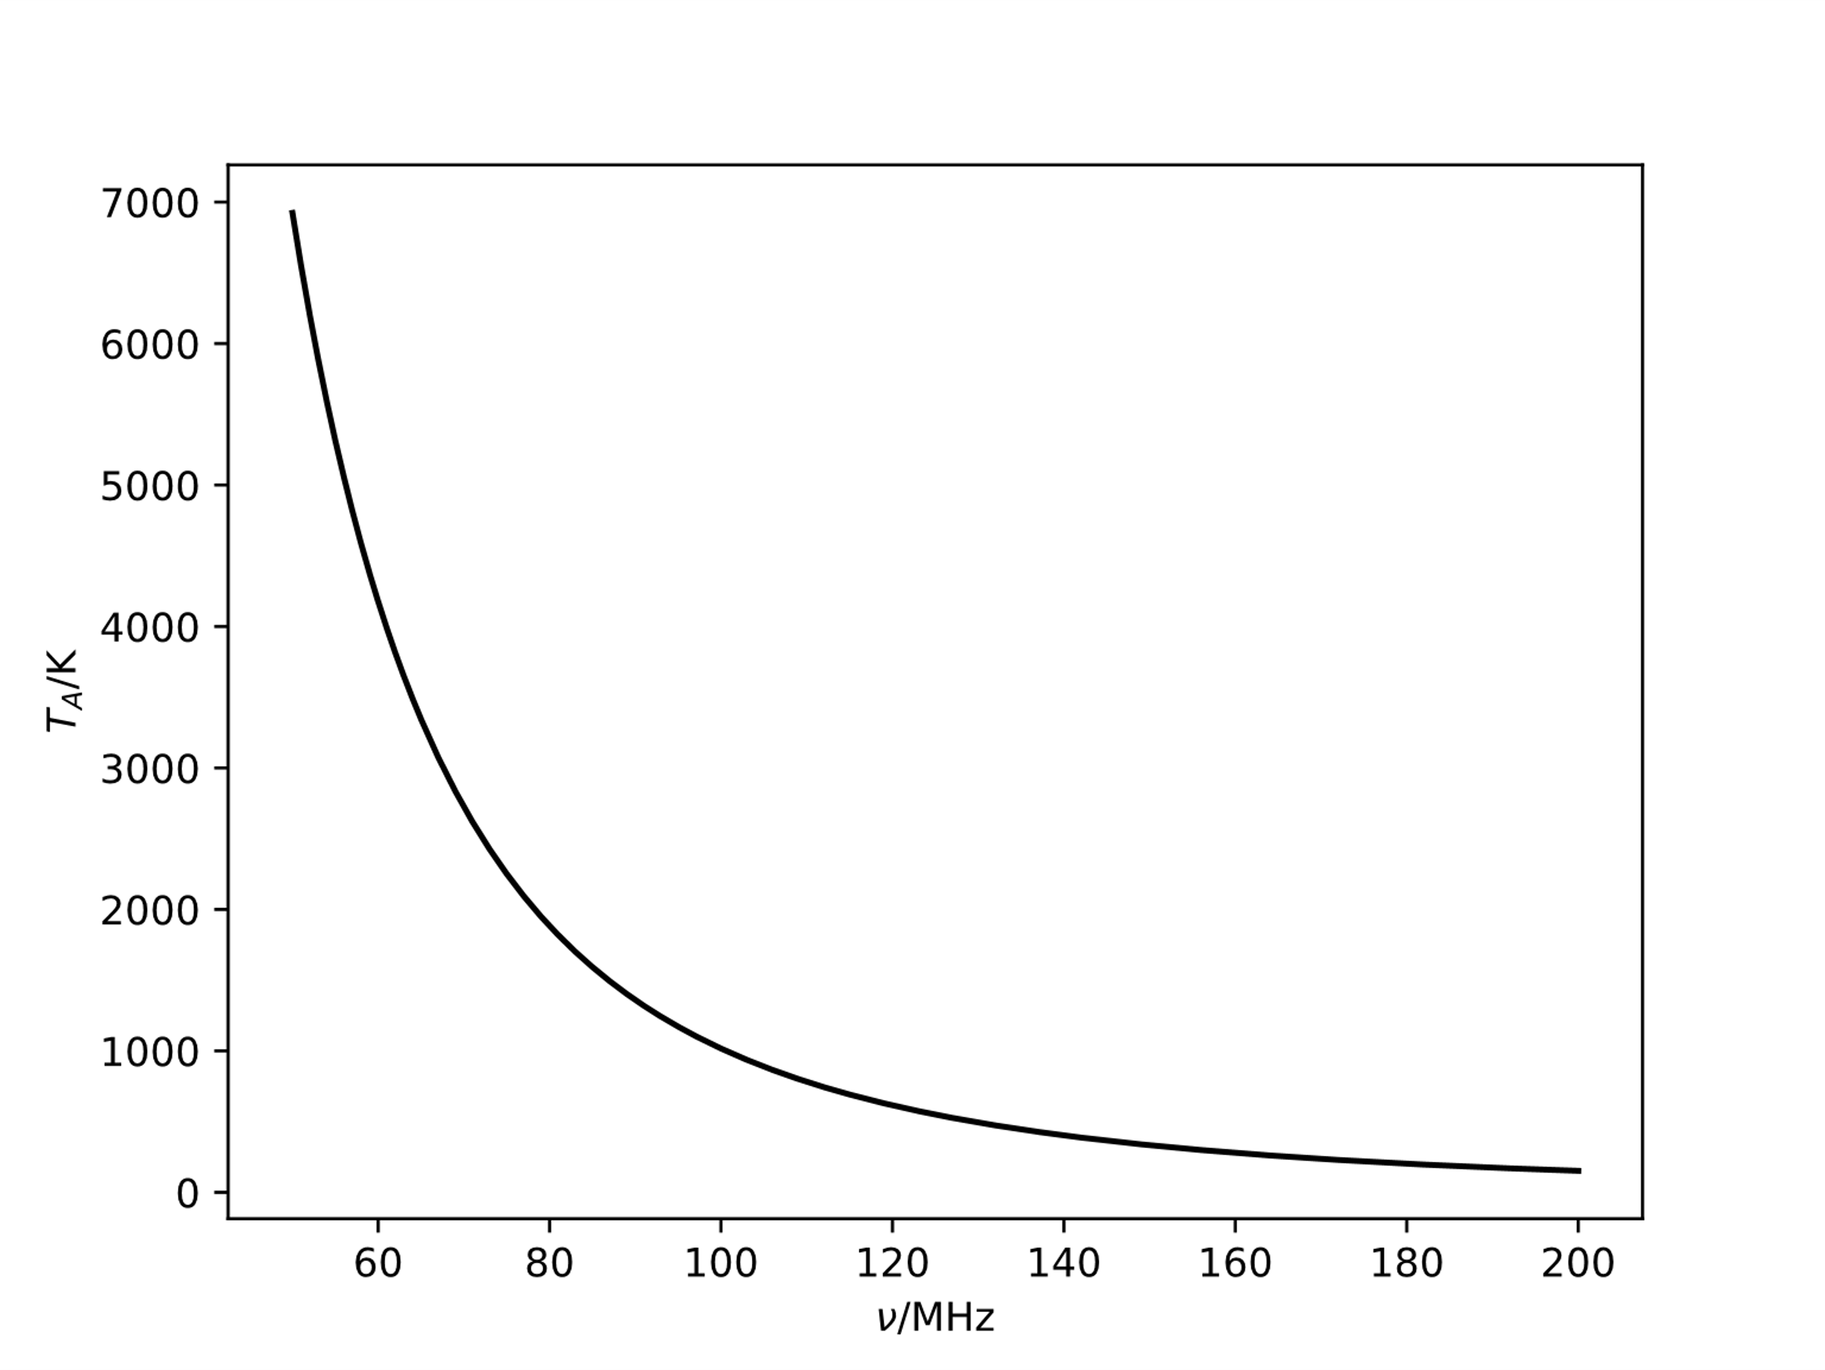

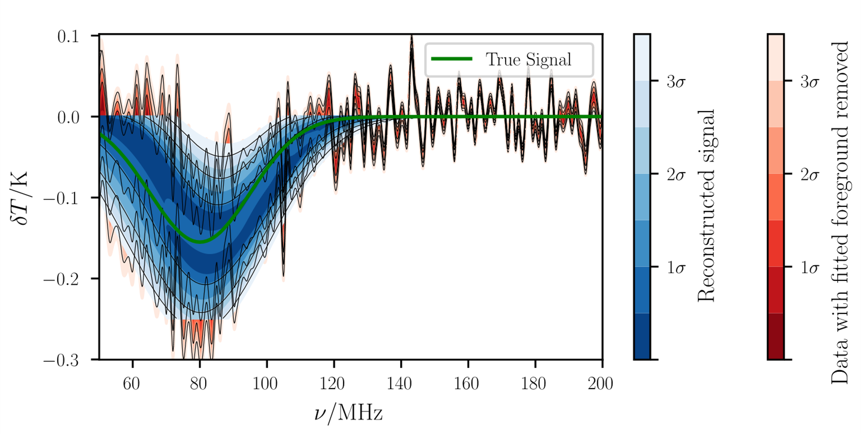
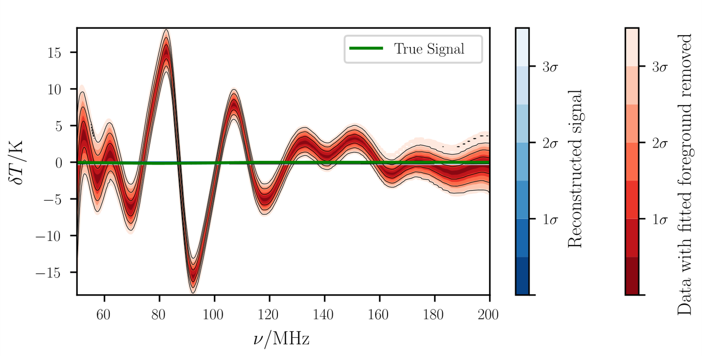
Radio Foregrounds and Chromaticity
Achromatic antenna
Chromatic antenna

Slide 6
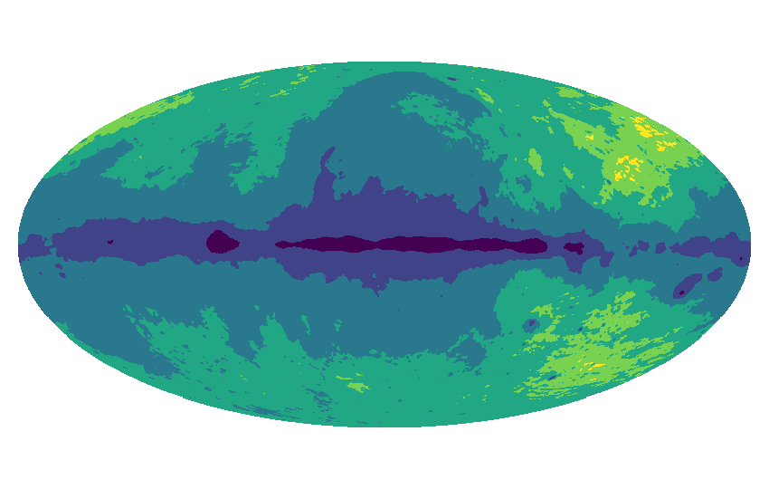
Summary of REACH Pipeline
β₆
β₅
β₄
β₃
β₂
β₁
Anstey et al. 2021

Slide 7
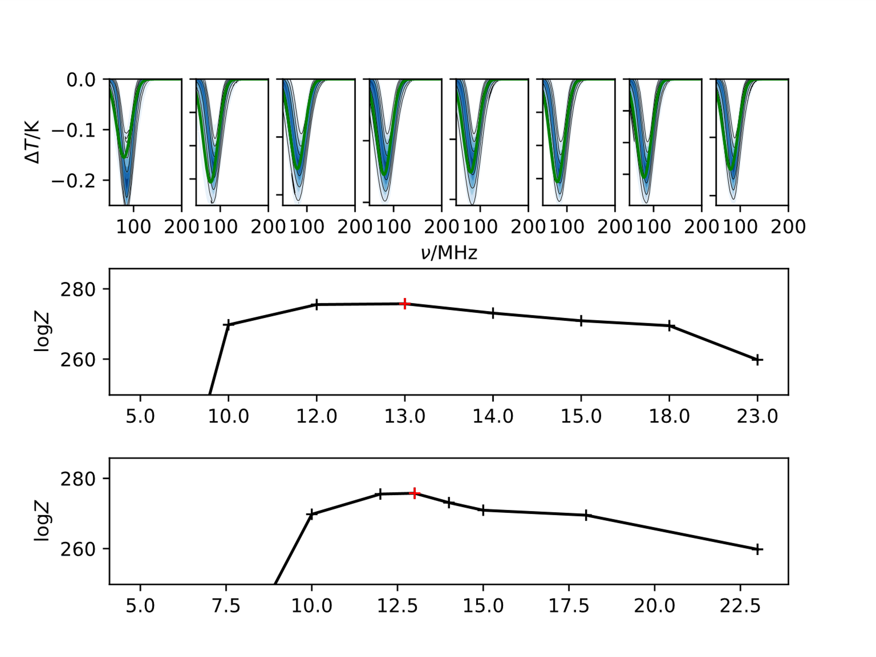
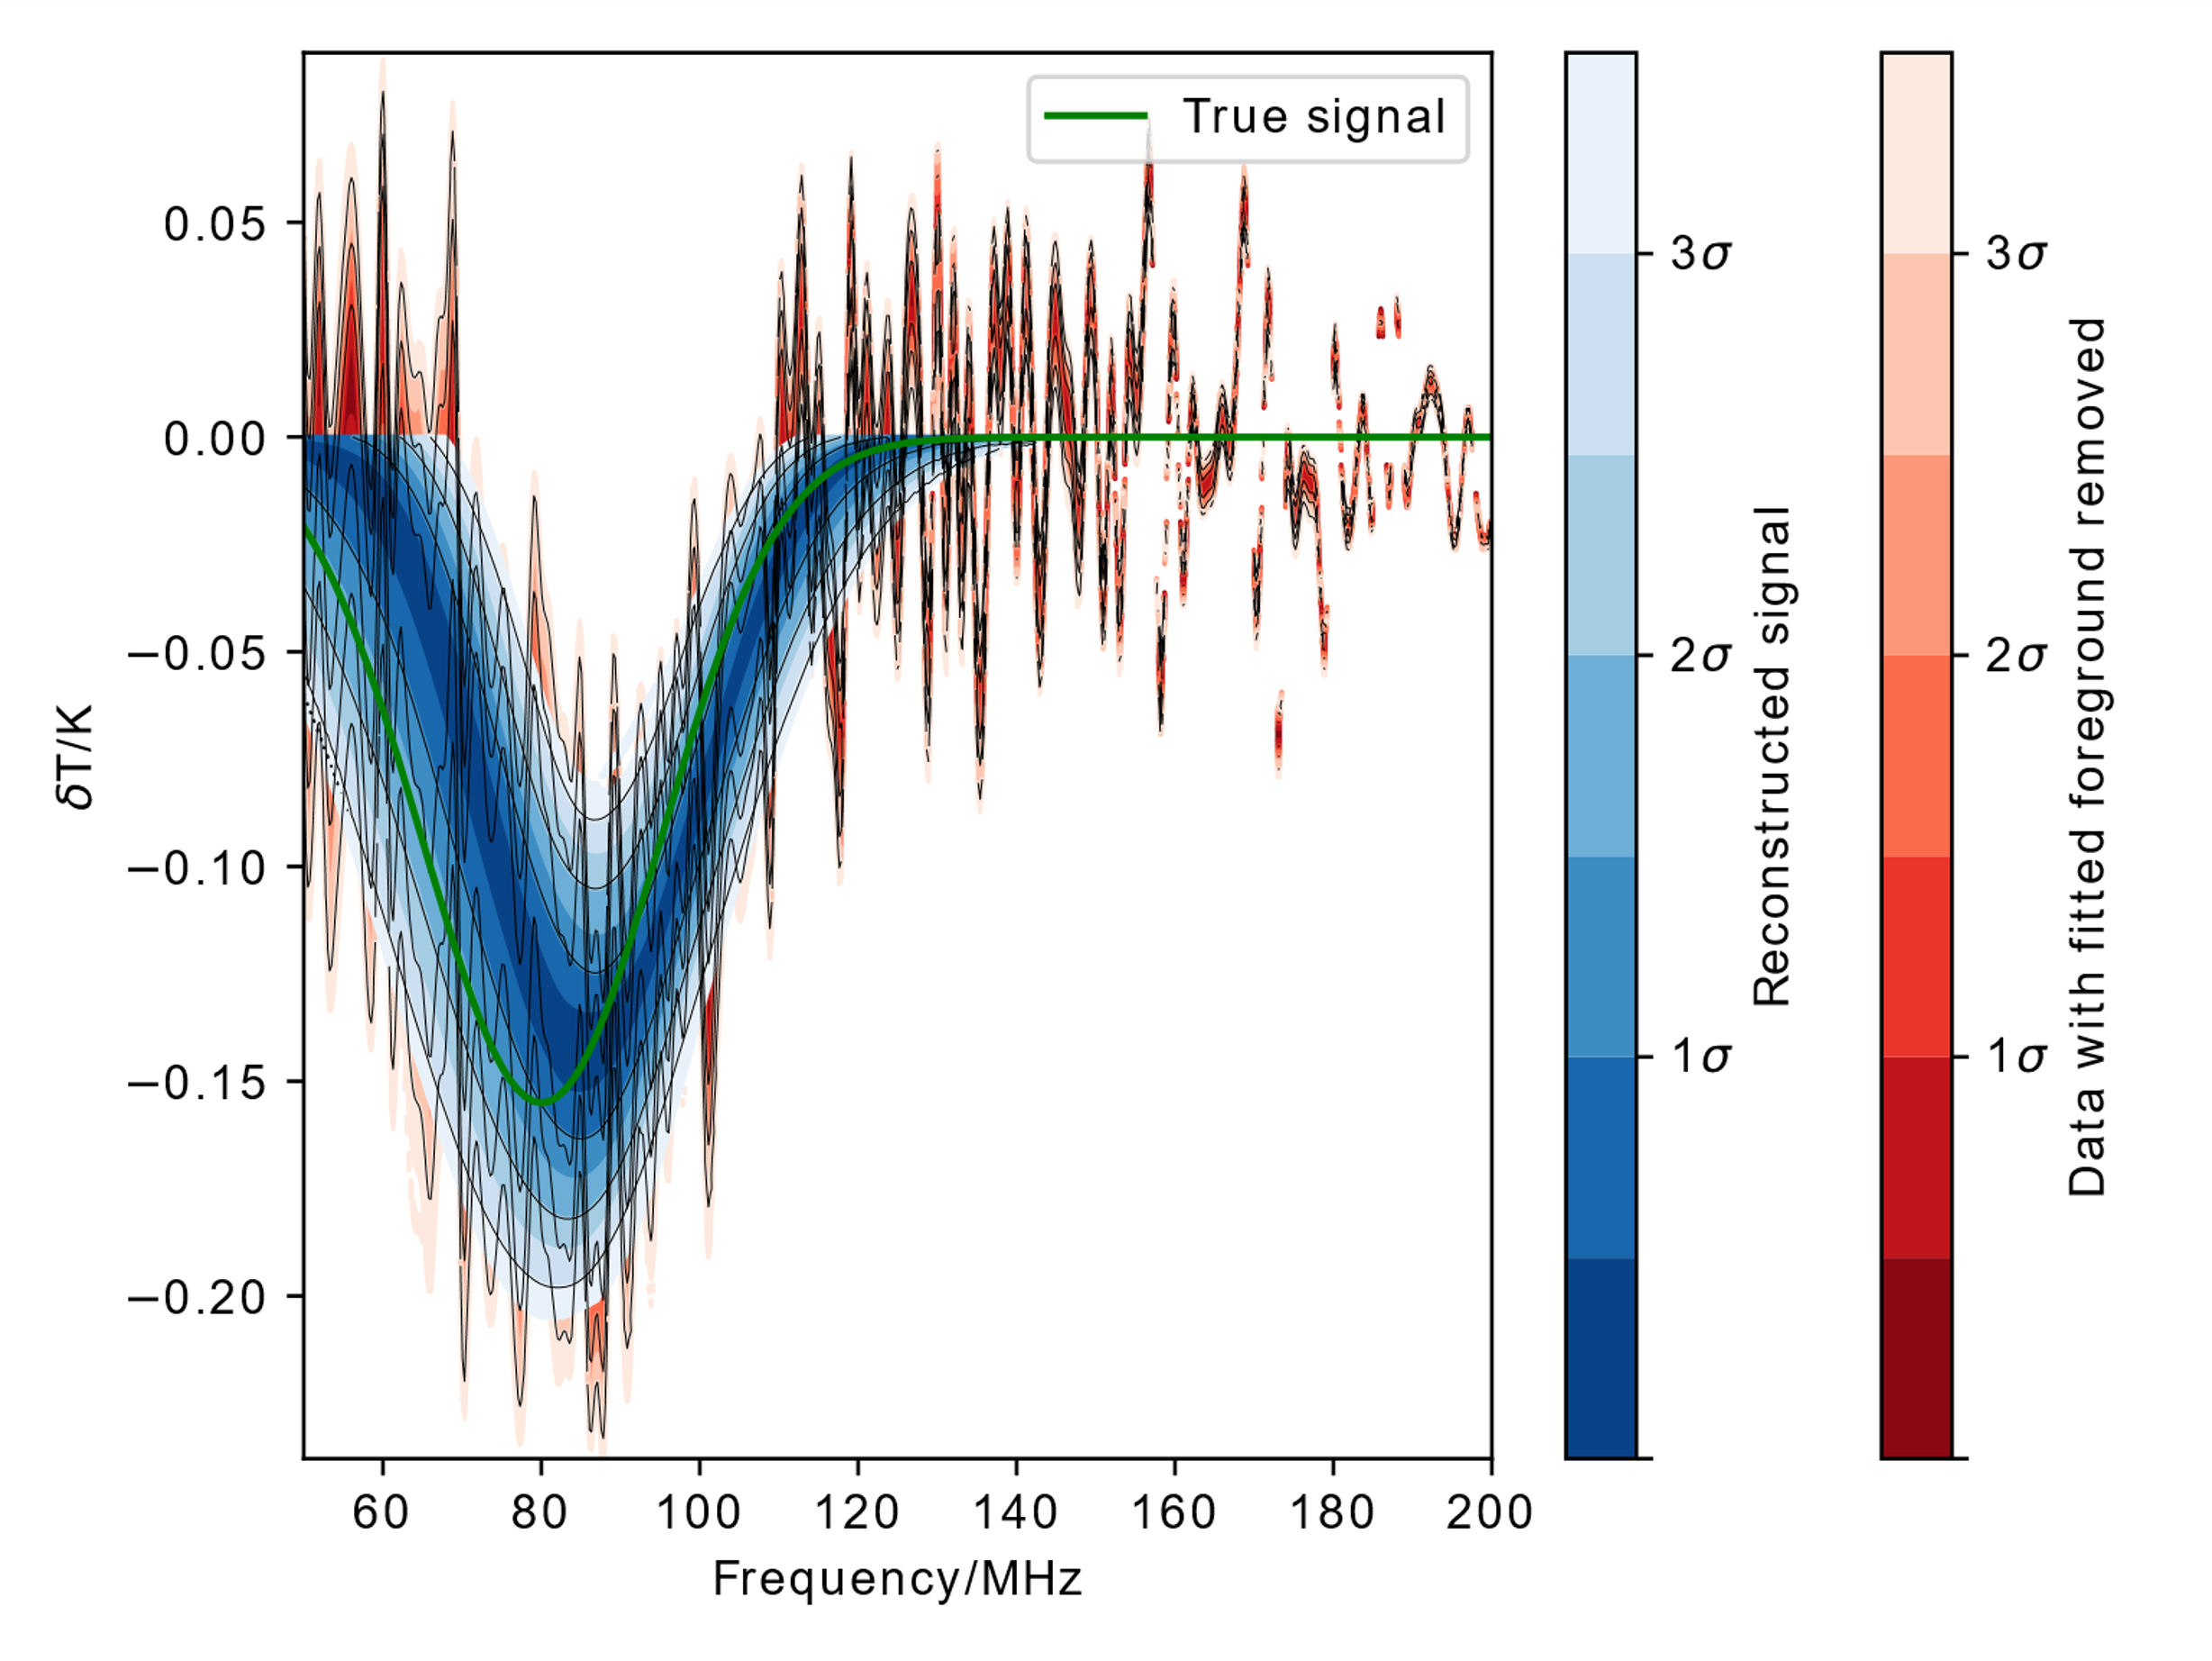
Performance

Slide 8
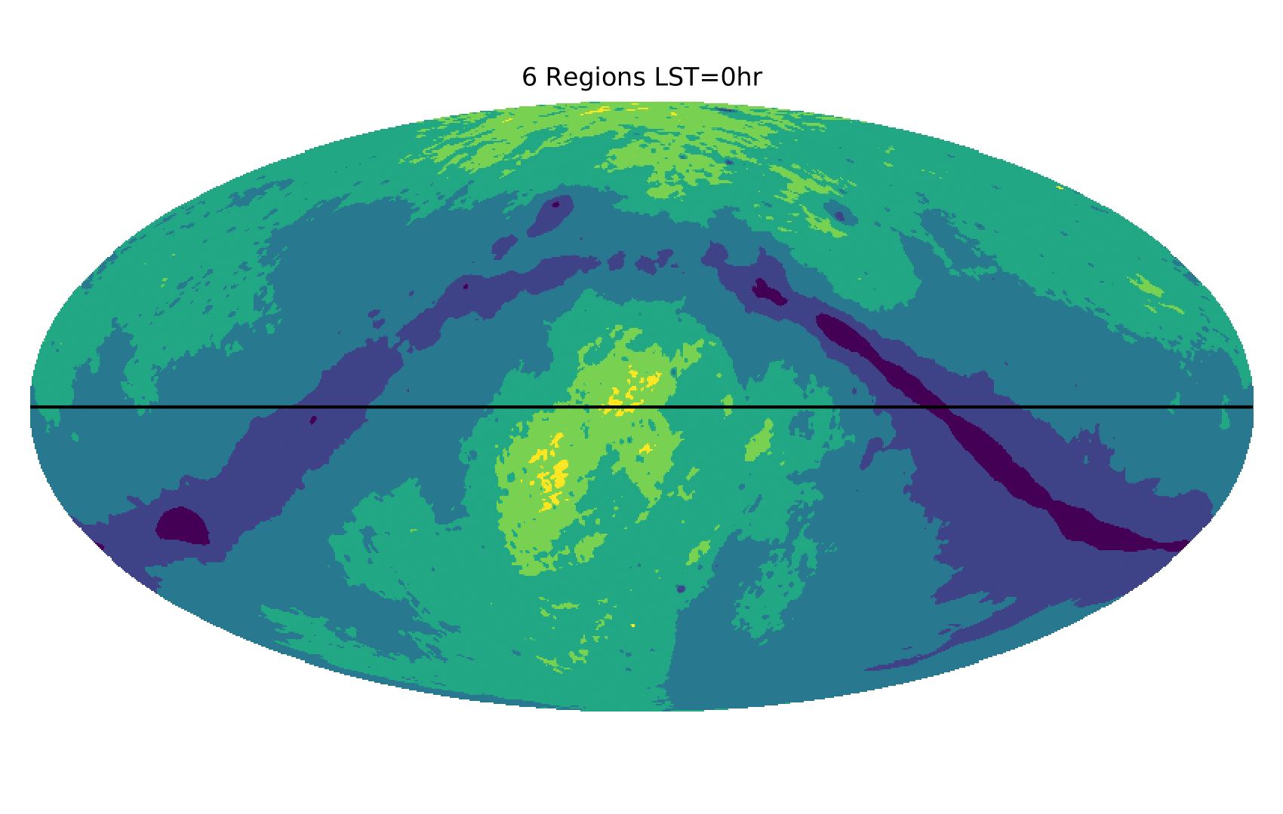
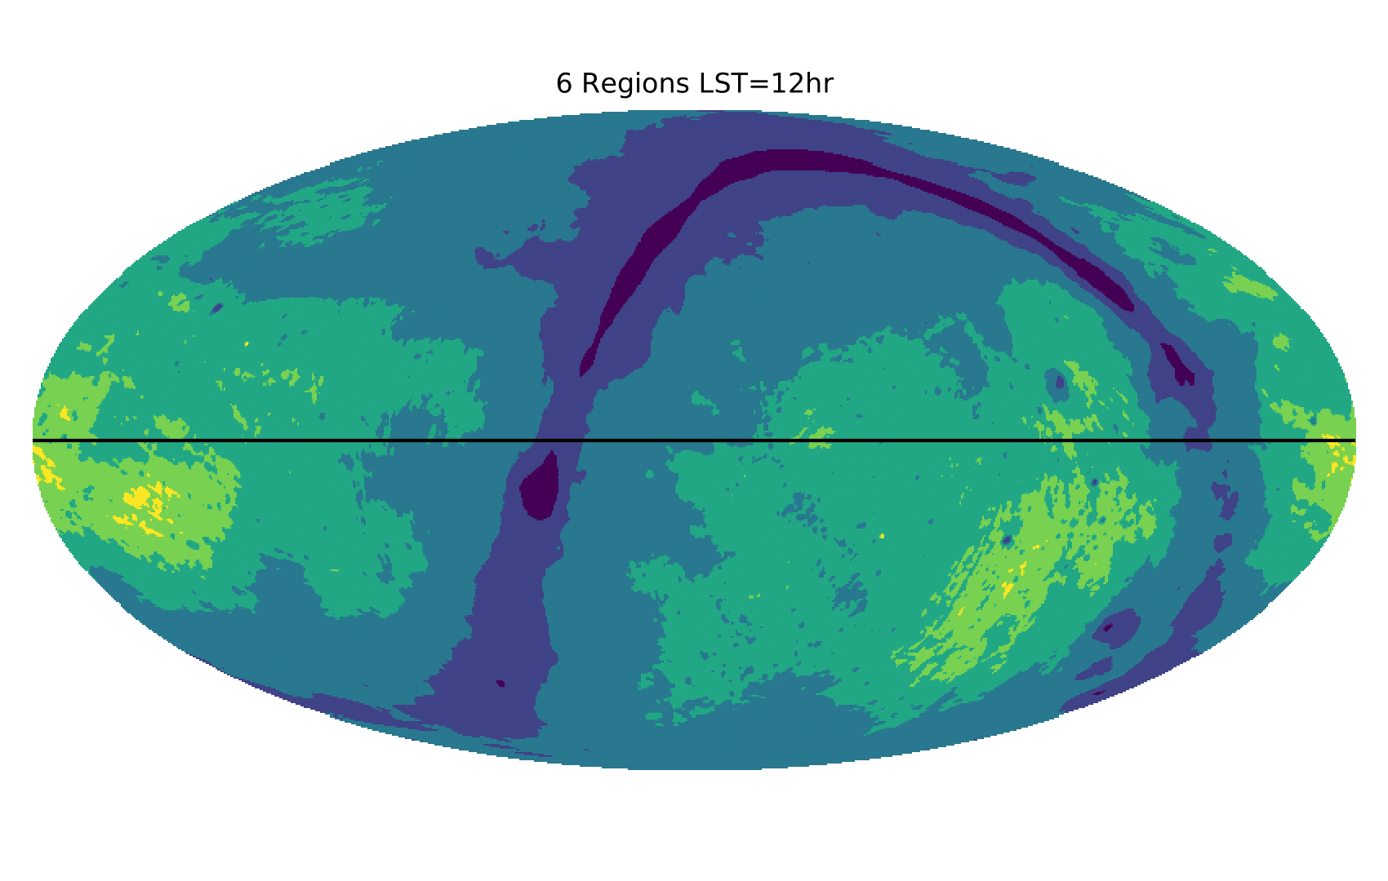
Time-Separated Fitting

Slide 9
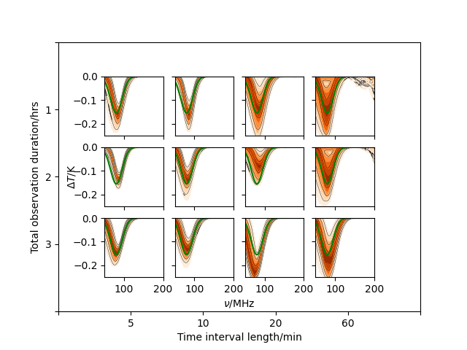
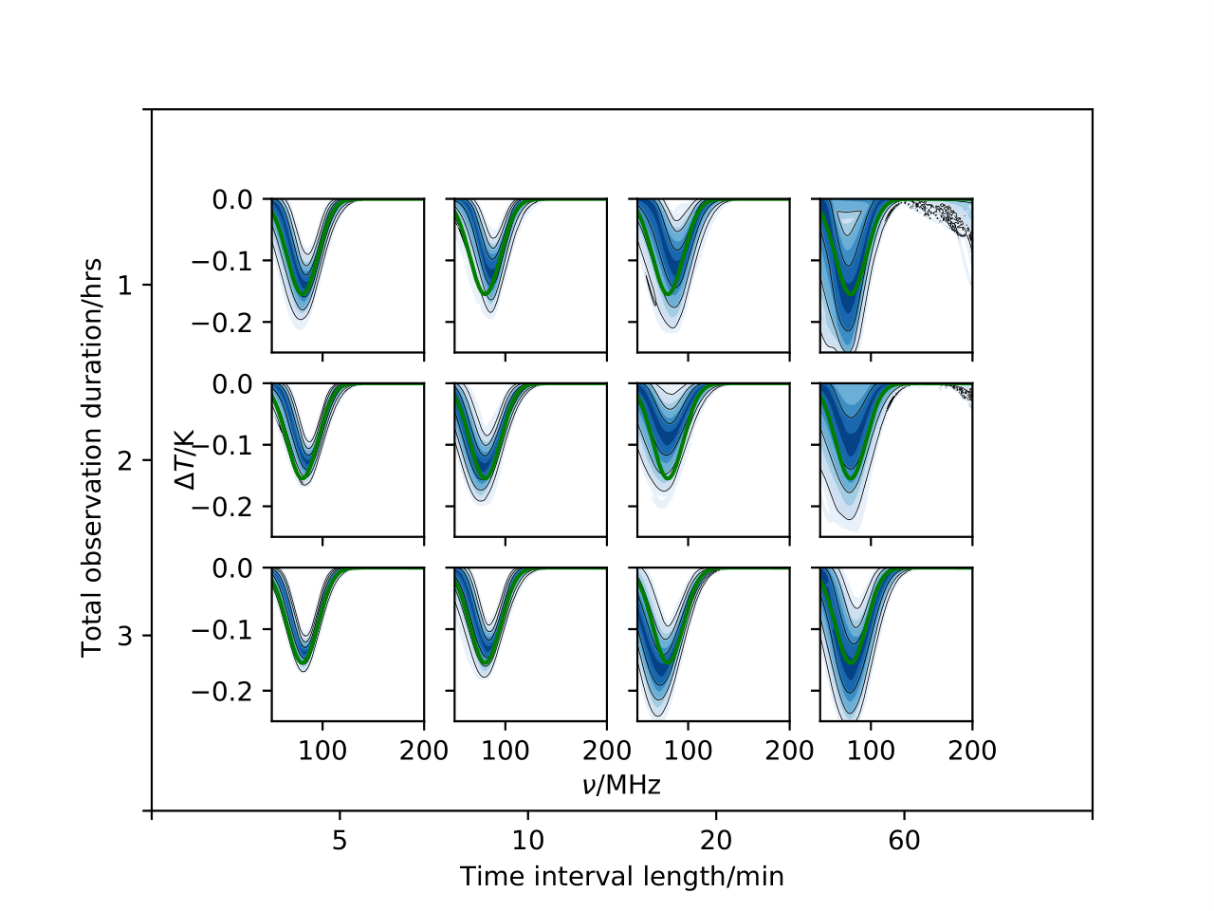
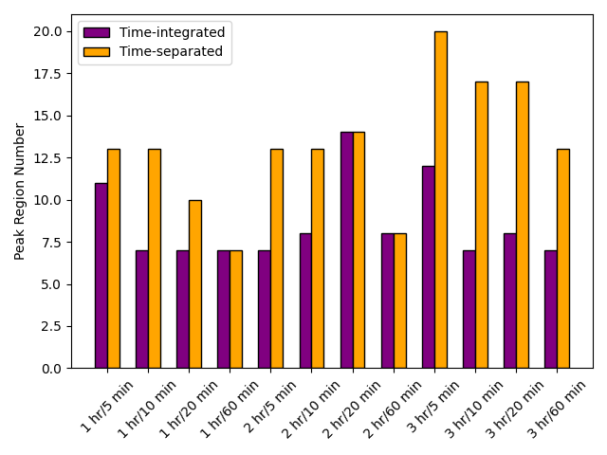
Time-Separated Fitting Results
Time-averaged
Time-separated

Slide 10
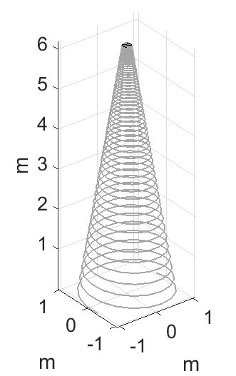
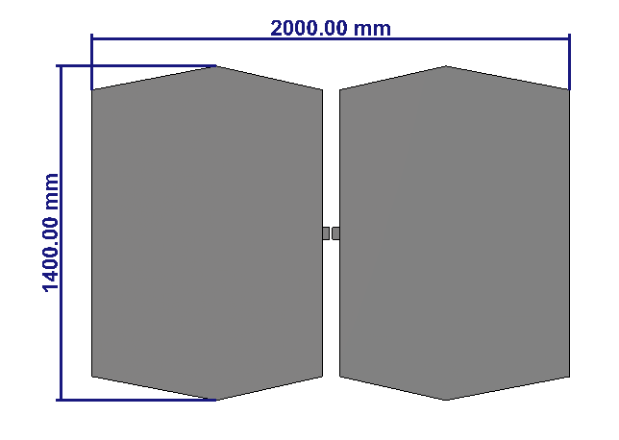
Multiple Antennae

Slide 11
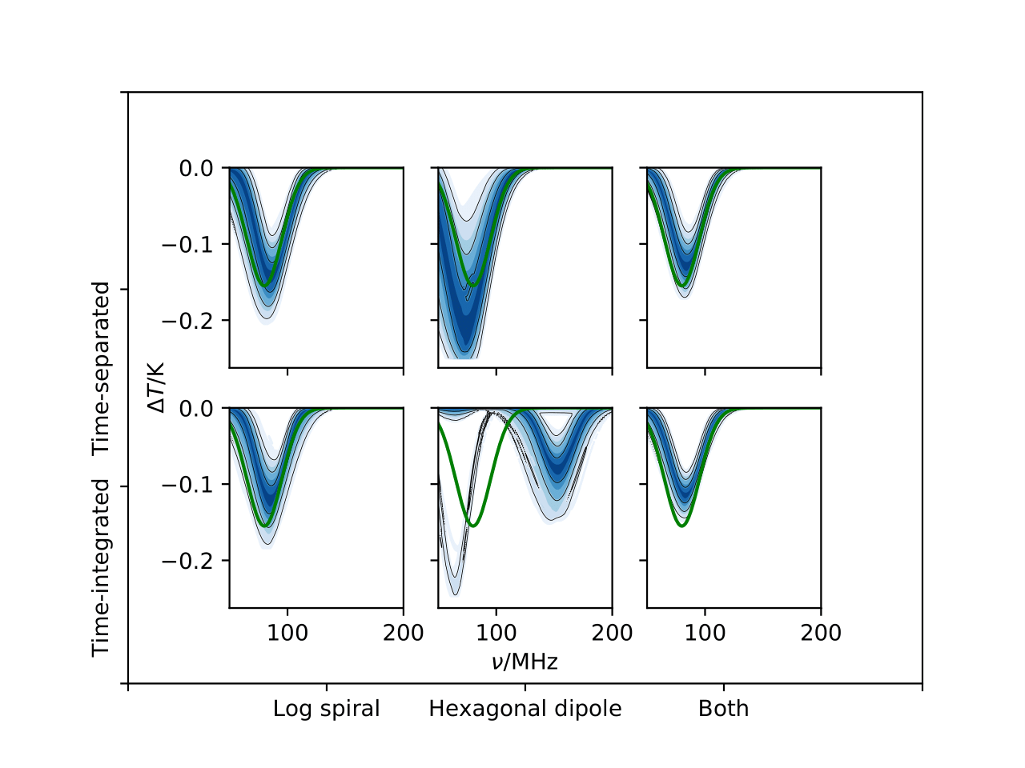
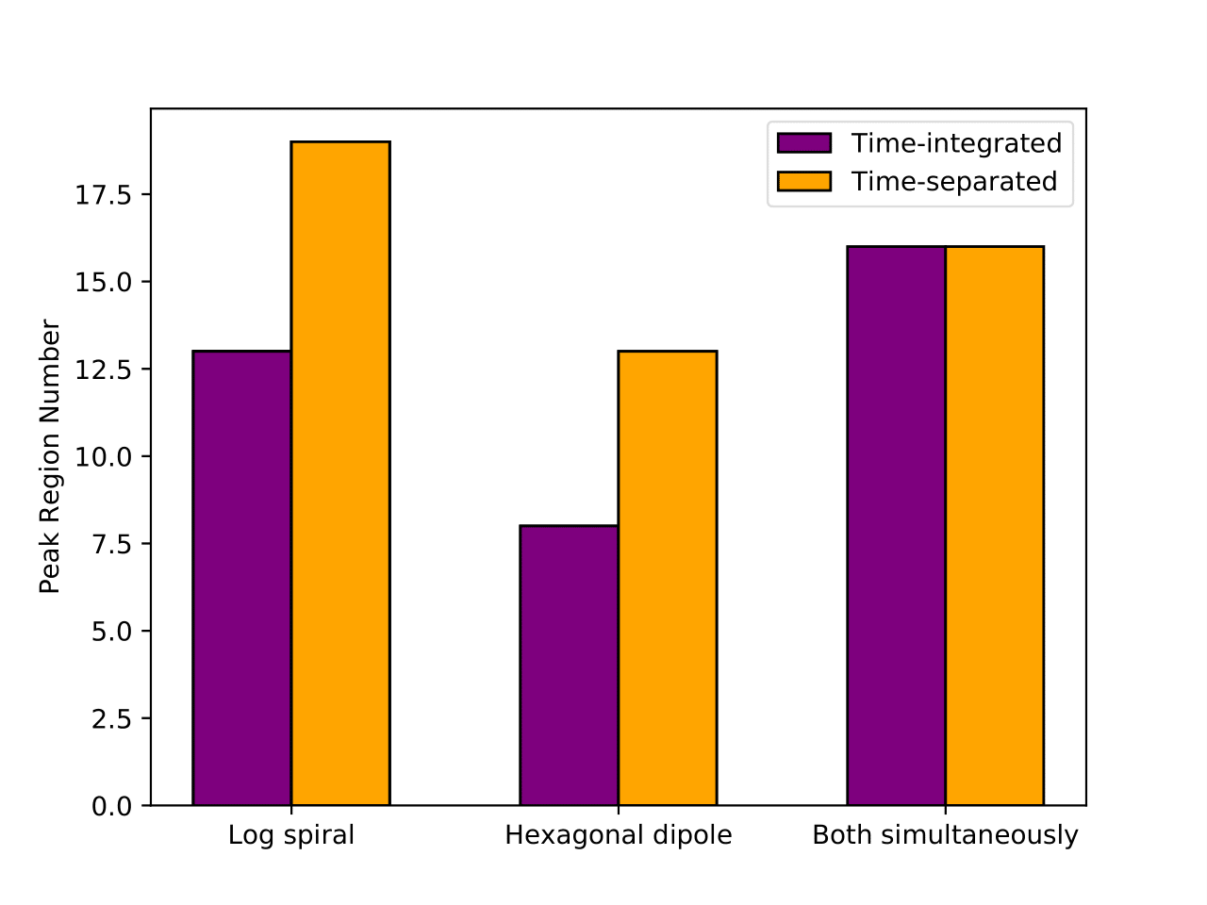
Multiple Antennae Results

Slide 12
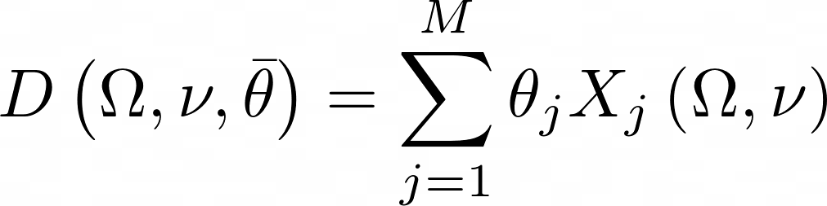
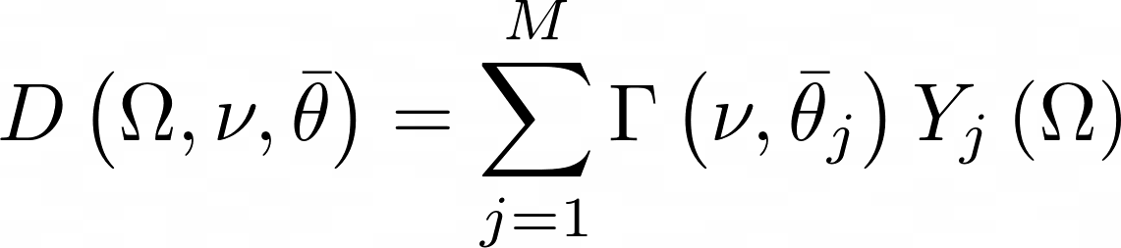
Antenna Beam Modelling
The antenna beam pattern may not be known exactly in practice:
Soil permittivity
Horizon effects
Imperfections in construction
Etc.

Slide 13
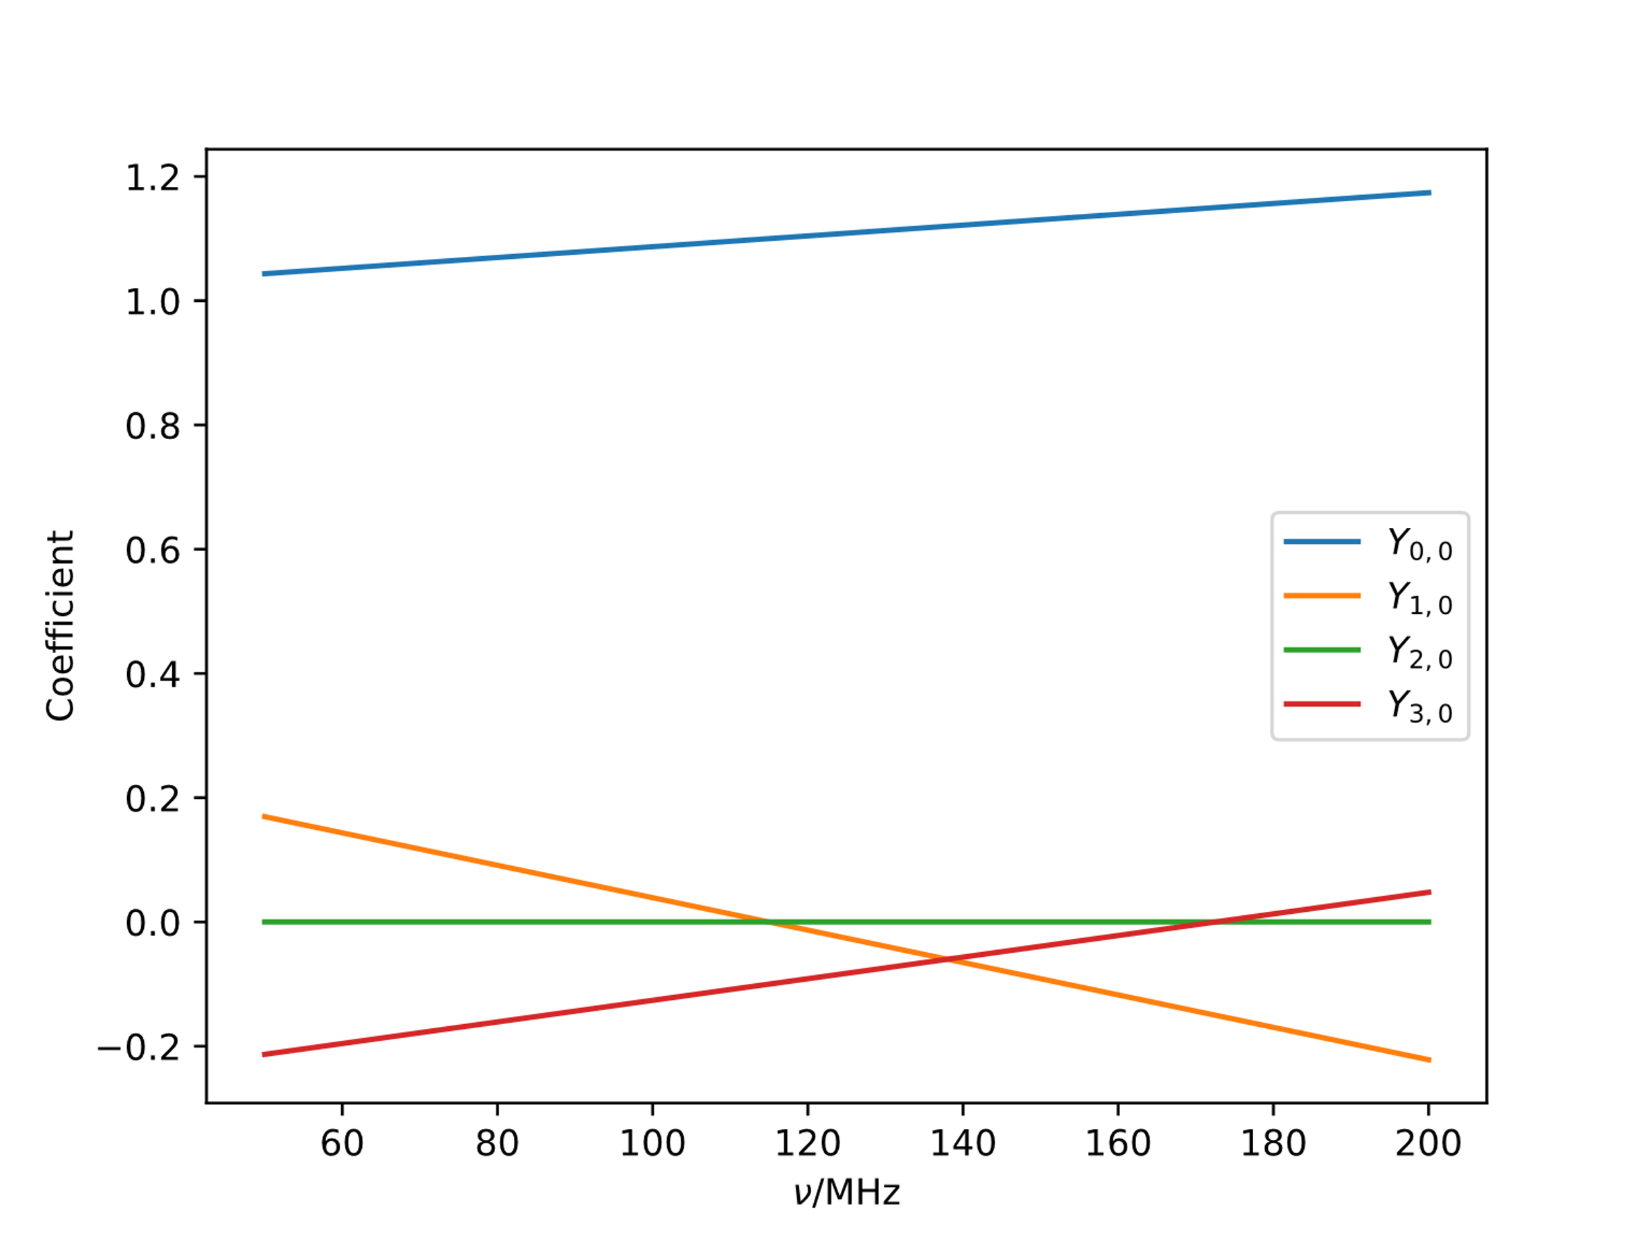
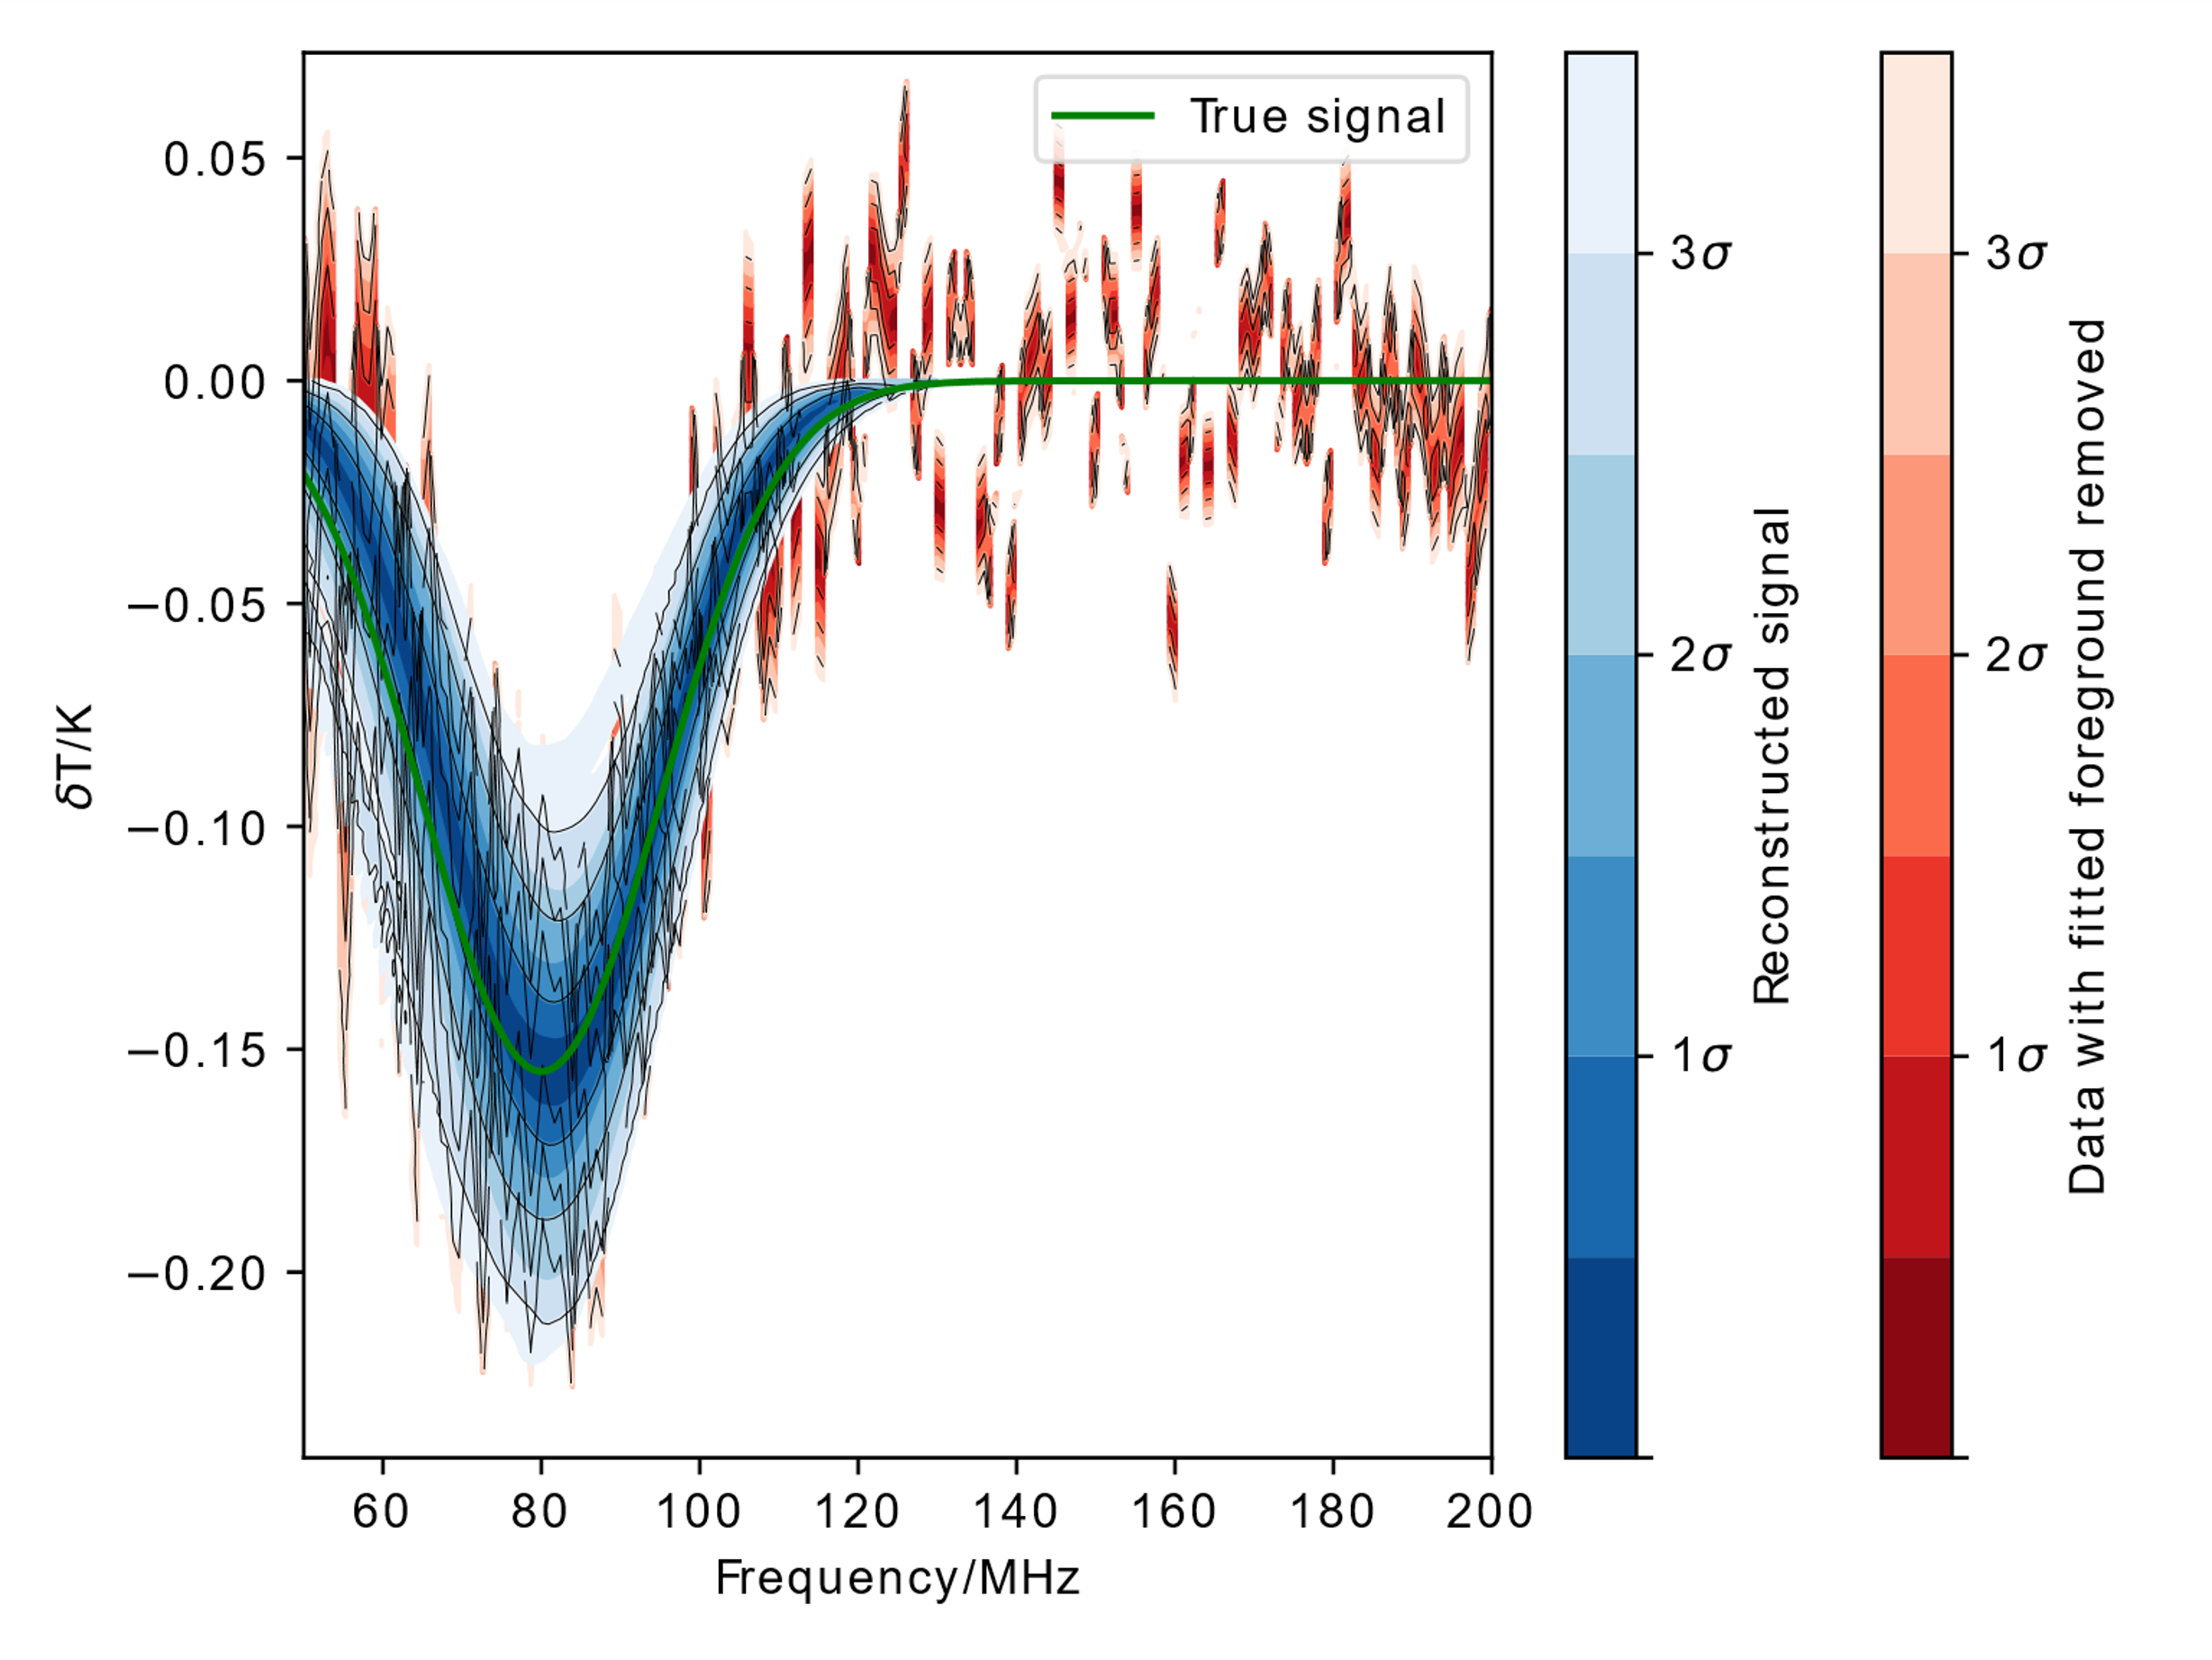
Fitting for Antenna Beam
Model Beam Coefficients
Fit Results

Slide 14
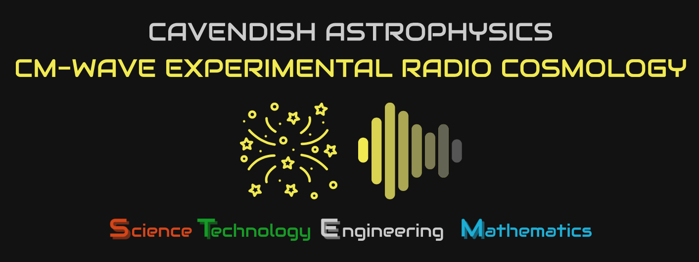



Conclusions
REACH is a global 21 cm experiment with a focus on physically-interpretable models, particularly of systematics
The REACH data analysis pipeline allows modelling of foregrounds and chromaticity based on spectral index
Using a constant physical property as the parameter allows data from multiple observing times and antennae to be fit simultaneously, giving improvements in signal and particularly foreground reconstruction
Ongoing work is underway to also model antenna beams
Antenna EM simulations provided by John Cumner and Quentin Gueuning
Plots produced using fgivenx tool: Handley, 2018

Slide 15


